Slide 1
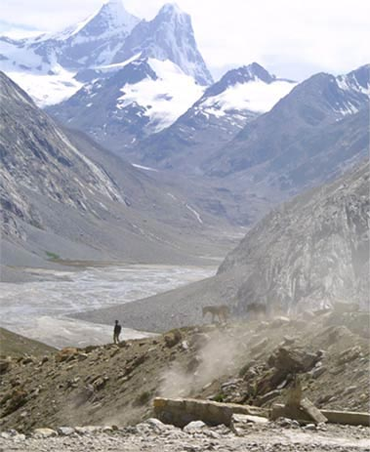
Fellowship of the Heart
Getting Started — the Four Connects, walked around the table on alternating evenings
Evening Series 2026–27 · at the Tittle home · v1.5E DRAFT
All Scripture: ESV · The Companion lesson plans carry the full scripts — these slides carry the room
1
Notes:
DECK TITLE · pre-session · DIVIDER
On screen as the room assembles on night one. All Scripture ESV; the plans carry the scripts; these slides carry the room — and these notes carry you.

Slide 2
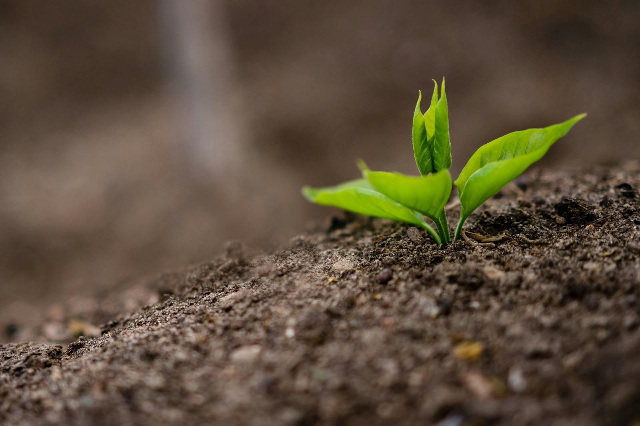
SESSION 2
The Soil of Your Heart
The Heart Soil diagnostic from Mark 4; beginning Connecting with Self
Quarter 1: Connect with Self & Others
21
Notes:
S2 · pre-session · DIVIDER
On screen through dinner and as the circle forms. Greet at the door — the slide holds the room.

Slide 3
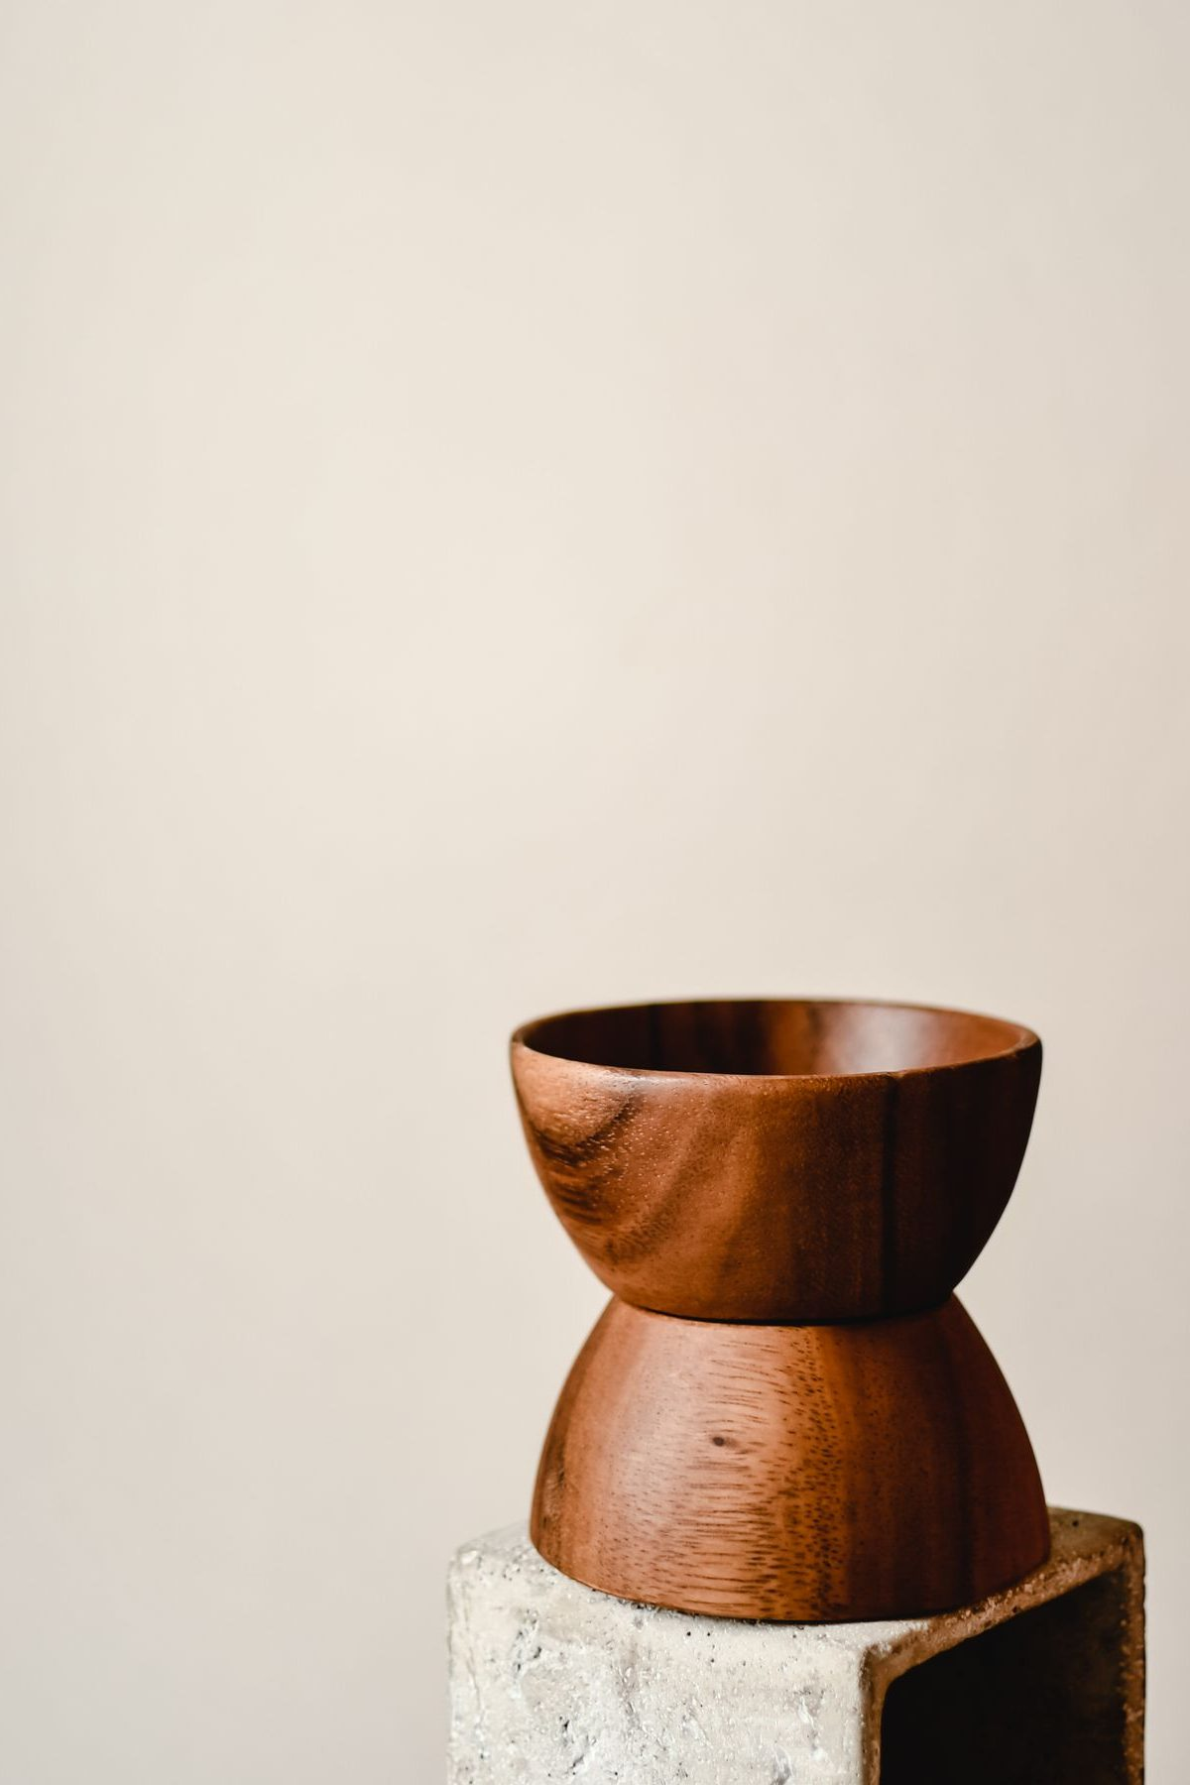
Session 2 — Tonight’s Road
1 Opening container — full eight-step protocol
2 Check-in on Week 1 practice
3 Teaching: the seed recalled; Mark 4, the soils, and Paul’s mixed ground
4 pairs: question zero, then the Heart Soil diagnostic
5 Re-merge — shared debrief; Mark 4:20 re-read
6 Homework commissioning — handout + check-in partners
7 The Leader Feedback Round — both leaders
8 Closing container + Aaronic blessing
22
Notes:
S2 · 7:00–8:30 · LEAD: BOTH LEADERS
BEATS:
1. Shape: full eight-step open, practice check-in, Mark 4 teaching, first move into FAMILY PAIRS for the Heart Soil diagnostic, merge, practice, close.
2. First pair night — frame it confidently: your family stays together, a parent goes first every time, you choose your own depth.
3. If the room is about ten or fewer, skip the pairs entirely — one circle all night.
CUES: pair spaces set before doors open; every leadsanion has done the diagnostic on themselves; the opening parent for each pair is arranged in advance.

Slide 4
Opening Container — the Full Eight Steps
1 Welcome — five minutes to open the container
2 Phones silenced and put away
3 Stand in a circle
4 One-word check-in — how you actually are, right now
5 Put out / bring in — set something down; bring a blessing in
6 Spoken commitment: “I am here. I am paying attention. I am willing to be moved.”
7 Opening prayer — “Holy Spirit, you are welcome here. Speak. We are listening.”
8 Sit. Begin.
23
Notes:
S2 · 7:00–7:08 · LEAD: CONTAINER HOLDER
BEATS:
1. Full eight-step opening protocol — the cohort knows the form; hold the rhythm, do not over-explain.
2. Four conditions: name them once; nods or a quiet yes are enough. Re-teach only if Week 1 felt unsafe.
3. Close the opening with brief prayer naming the Holy Spirit — ask Him to teach us through Jesus' own words today.
CUES: At the one-word check-in, listen for heavy words ('angry', 'numb', 'scared') — note them; the diagnostic may pull from there.

Slide 5

Check-In on Week 1 Practice
• One quick round, one sentence each — a parent starts
– “One thing I noticed this week when I asked the morning question …”
– Or one thing about the practice itself — “I forgot it three days running” is a real answer
• No grades, no lectures — honesty over performance
• Missed it? “Thanks for the honesty. Pick it back up tomorrow.”
“When your children ask their fathers in times to come, ‘What do these stones mean?’”
— JOSHUA 4:21 (ESV)
24
Notes:
S2 · 7:08–7:25 · LEAD: CONTAINER HOLDER
BEATS:
1. Parent Co-Companion leads and models first with one true sentence ('I checked my phone before the question most days').
2. One quick sentence each around the circle — what I noticed, or what I noticed about the practice. Honor passes without ceremony.
3. Teach the anchor once, thirty seconds: Joshua 4 — twelve stones from the Jordan. Every week this check-in adds a stone.
GUARD: No grading, no lecture on consistency. 'I didn't do it' gets 'Thanks for the honesty. Pick it back up tomorrow.'

Slide 6
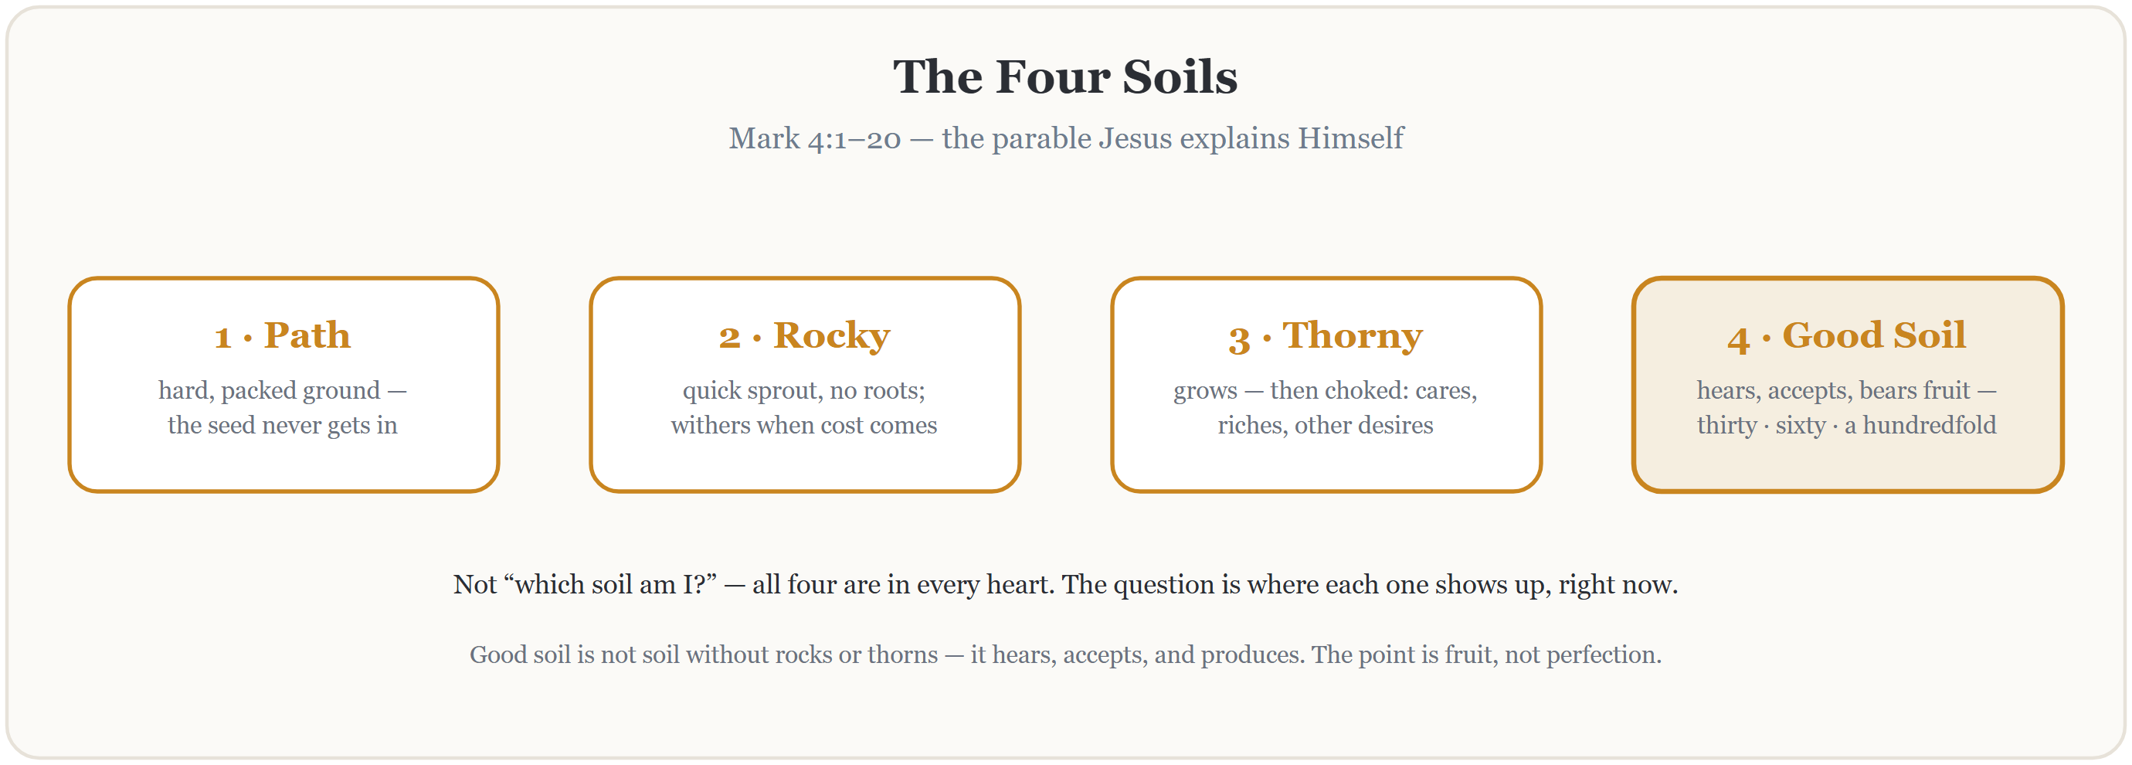
Teaching — Mark 4 and the Four Soils
Read Mark 4:1–20 in full, slowly — all twenty verses, no commentary. Then the seed, recalled — sixty seconds. Then the four soils — and Paul’s mixed ground, next slide.
25
Notes:
S2 · 7:25–7:39 · LEAD: CONTENT PRESENTER
BEATS:
1. Read Mark 4:1–20 in full from the physical Bible — slowly, all 20 verses, no stopping to comment.
2. Recall the seed, 60 seconds: 'the sower sows the word' — today is about the ground it lands on, yours and mine.
3. Walk the four soils in six minutes max: path (hard, taken), rocky (fast, rootless), thorny (choked, fruitless), good (hears, accepts, produces — fruit, not perfection).
GUARD: At path soil, name the enemy plainly — no dramatizing, no denying. Save the back of the block for Paul.

Slide 7
Paul’s Mixed Ground — Romans 7
ROMANS 7:15, 18–19
“For I do not understand my own actions. For I do not do what I want, but I do the very thing I hate… For I have the desire to do what is right, but not the ability to carry it out. For I do not do the good I want, but the evil I do not want is what I keep on doing.”
ROMANS 7:24–25
“Wretched man that I am! Who will deliver me from this body of death? Thanks be to God through Jesus Christ our Lord!”
Mixed soil, in the mouth of an apostle — and he lands on rescue, not despair. All four soils in one honest week is not failure. It is apostolic company.
26
Notes:
S2 · 7:25–7:39 · LEAD: CONTENT PRESENTER
BEATS:
1. Paul's mixed ground, 3 min: read Romans 7:15, 18–19 — an apostle with all four soils at once.
2. Land where Paul lands, 7:24–25: rescue, not despair. Finding rocks and thorns is apostolic company.
3. Pivot: the wrong question is 'which soil are you?' — the right one is 'where does each show up, specifically, this week?'
CUES: Bridge before the 4:40 move: restate the container for the pairs — what your family says today is a gift, not ammunition; it does not come up in the car. Wait for nods from each family before anyone moves.

Slide 8
Question Zero — Private, Journal Only
2 CORINTHIANS 13:5
“Examine yourselves, to see whether you are in the faith. Test yourselves.”
Has the seed itself ever gone into your ground? Has there been a time you actually said yes to Jesus — your yes, not your family’s?
Write your honest answer — yes, no, or I’m not sure. Nobody shares this one.
If it’s no, or not sure — the road is short. The thief walked it in one sentence. Any Companion, any Wednesday, quietly — or start with your parent, tonight, in the car.
27
Notes:
S2 · 7:40–8:10 · LEAD: CONTENT PRESENTER · PAIRS
BEATS:
1. First three minutes of pair time. Journals open to the Question Zero page; scripture asks it — 2 Corinthians 13:5.
2. Read it once: has the seed itself ever gone into your ground — your yes, not your family's? Write yes, no, or not sure. The road is short; the thief walked it in one sentence.
3. Three quiet minutes. Do not walk the circle; do not glance at pages.
GUARD: Question zero is PRIVATE and journal-only — never shared, never referenced again, today or ever. No 'anyone want to say anything about the first one.' The quiet seeker who finds a Companion afterward is the year's best outcome, not a crisis.

Slide 9
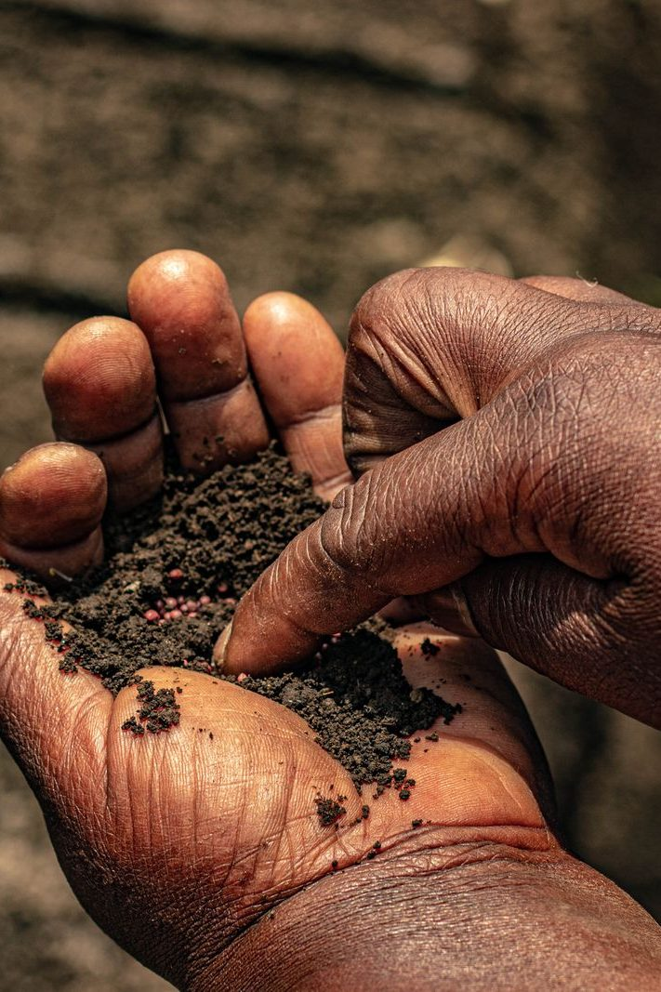
pairs — the Heart Soil Diagnostic
• Not “which soil am I?” — where does each soil show up in my life right now? Specifically.
1 Path — where is the ground hard right now? One specific place, this week
2 Rocky — where has a season with God not lasted? What sun revealed the missing roots?
3 Thorny — what is choking me right now: cares, riches, other desires? Which is loudest?
4 Good — where has something God planted actually grown? Name one real piece of fruit
• Journal two minutes, then share — a parent answers first, every round
• “I’d rather not share that one” is a complete answer — a gift, not ammunition
28
Notes:
S2 · 7:40–8:10 · LEAD: CONTENT PRESENTER · PAIRS
BEATS:
1. Four questions, one at a time: path, rocky, thorny, good. About two minutes journaling each, then share around — 'I'd rather not share that one' is a complete answer.
2. Push for one specific incident, not a category — 'my phone' becomes one moment this week.
3. Nobody fixes anybody across the family line: 'Just receive it. We're noticing today, not fixing.'
CUES: The arranged parent opens the first round — never a cold call, never on a teen. Watch the clock privately: question zero plus four questions in 28 minutes. Ten or fewer today — run it as one whole circle.
GUARD: Heavy material ('rocky is when we fight at home') — acknowledge, hold, move on; follow up per Handbook Section 6. Watch a teen's face while their parent shares.

Slide 10
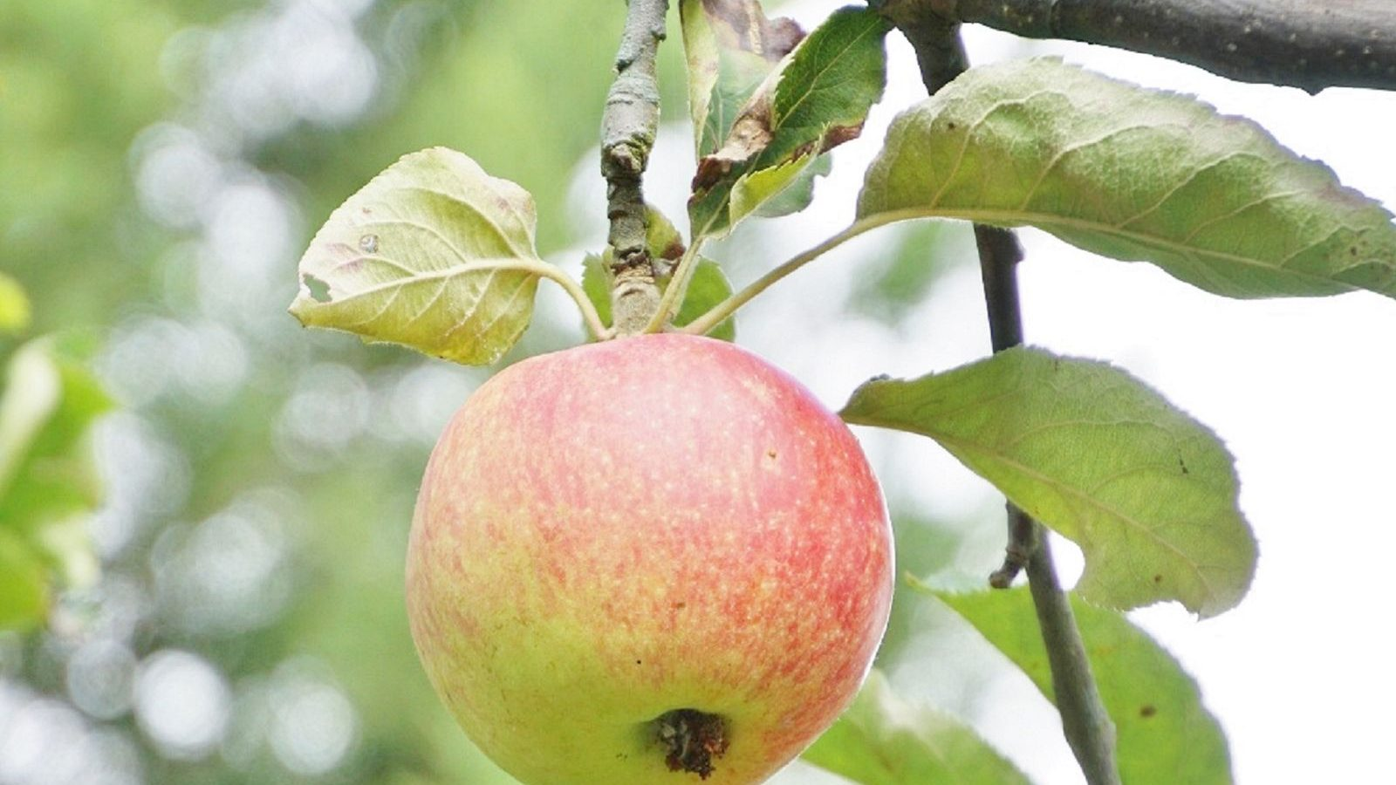
Re-Merge — One Word, Then the Verse
• What surfaced stays in your pair — here, just one word from each of us
• Then the verse Jesus ends with, read slowly — listen for the word that lands
• Noticing rocks and thorns is not the opposite of good soil — it is what good soil does
MARK 4:20
“But those that were sown on the good soil are the ones who hear the word and accept it and bear fruit, thirtyfold and sixtyfold and a hundredfold.”
29
Notes:
S2 · 8:11–8:20 · LEAD: CONTENT PRESENTER
BEATS:
1. Re-merge starts at 5:09 — three minutes to move; let the circle settle.
2. One word each on what today surfaced — 'thorny', 'seen', 'tired'. Hold each word a beat.
3. Re-read Mark 4:20 slowly; land it: good soil is not soil without rocks — it hears, accepts, produces. The noticing IS what good soil does.
GUARD: No specifics from the pairs — the diagnostic stays in the pair; the merge is for landing, not repeating.

Slide 11

Homework — Two Weeks, Four Parts
• The Soil Journal — three times this week, five minutes each. Not every day; three times.
– Today, where did the path show up? The rocky? The thorny? The good soil?
– One sentence per soil. Specific, not general.
• No fixing. We notice; the Spirit fixes.
• Keep the morning question going too: “Father, what are you up to today?” The practices stack.
30
Notes:
S2 · 8:20–8:24 · LEAD: CONTENT PRESENTER
BEATS:
1. Parent Co-Companion leads. Three times this week — not daily — five minutes: one sentence per soil, where did each show up today? Specific, not general.
2. Rule stands: no fixing. The Spirit fixes; our job is to pay attention.
3. Keep last week's morning question going — the two practices stack.

Slide 12
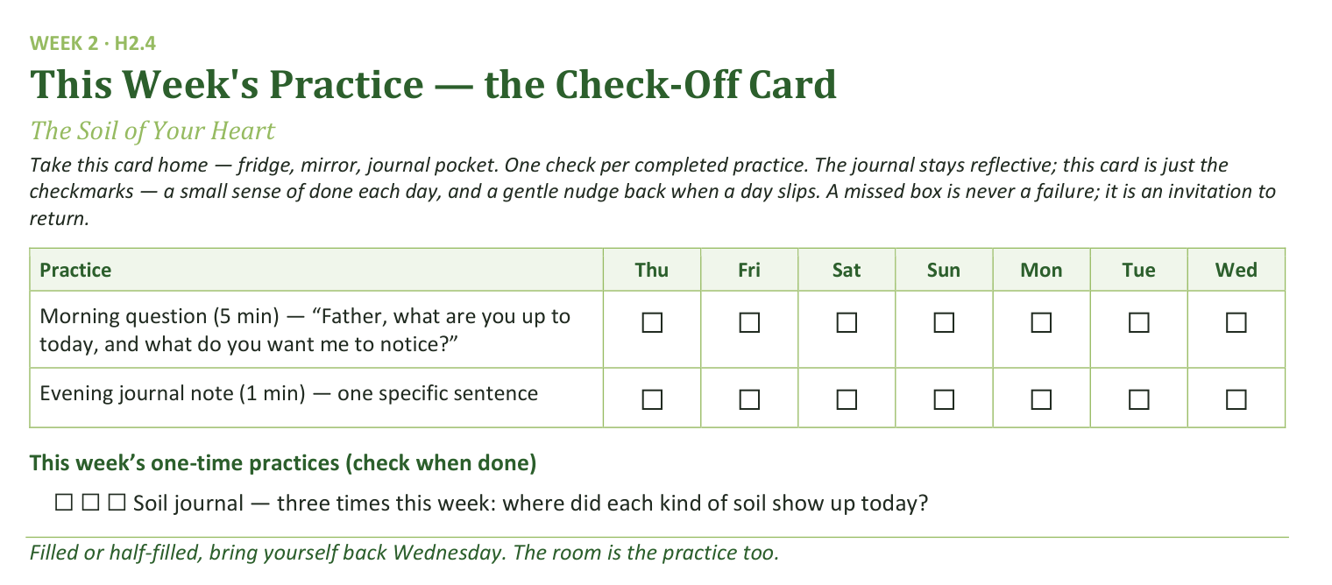
Your Take-Home Card — This Session’s Practice
Handed out now — fridge, mirror, journal pocket.
31
Notes:
S2 · 8:20–8:24 · LEAD: CONTENT PRESENTER
BEATS:
1. Hold up the check-off card (H2.4): daily morning question and evening sentence, plus three soil-journal boxes.
2. A missed box is never a failure — it is an invitation to return.
CUES: Rides inside the practice block — keep both slides to five minutes together.

Slide 13
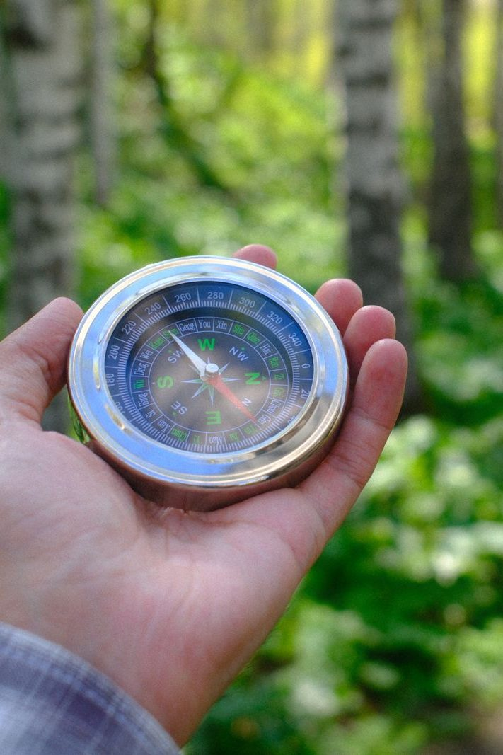
The Leader Feedback Round
• Two rounds, same as every session — the container holder first, then the content presenter: three things each
– “What I think went well tonight: ______”
– “What I’d do differently next time: ______”
– “If I were to teach tonight’s process to someone, I would tell them: ______”
• Then the room — the same two questions about tonight
• The leaders receive without defending — “thank you” is the whole response
32
Notes:
S2 · 8:24–8:28 · LEAD: BOTH LEADERS
BEATS:
1. Your three things first: what went well; what I'd do differently; what I'd tell someone teaching today's process.
2. Room's two questions; two or three voices is plenty.
3. Receive without defending — 'thank you' is the whole response.
CUES: May be dropped if the room's energy needs something else; dropping it twice running goes to the team debrief.

Slide 14
Closing the Container + Aaronic Blessing
• We close the way we opened — the container, six steps:
1 Stand again — same circle, same posture as the open
2 One-word landing — compare it to your opening word
3 The one thing you are taking from tonight
4 The one practice — committed aloud, or modified to one you will actually keep
5 Blessings — specific, witnessed, short
6 Closing prayer — and the Aaronic blessing, spoken over each other, face to face
THE AARONIC BLESSING — NUMBERS 6:24–26
“The Lord bless you and keep you;
the Lord make his face to shine upon you, and be gracious to you;
the Lord lift up his countenance upon you, and give you peace.”
33
Notes:
S2 · 8:28–8:30 · LEAD: CONTAINER HOLDER
BEATS:
1. Abbreviated six-step close: one-word landing, one thing I'm taking, one practice (the three soil journals).
2. Aaronic blessing parent-to-teen, teen-to-parent — the cohort knows the form now.
3. Brief closing prayer naming, without details, what surfaced: 'Father, You saw the rocks and the thorns we named today.'
GUARD: If the merge ran heavy, give the prayer 60–90 seconds; do not lighten the room.

